Slide 1
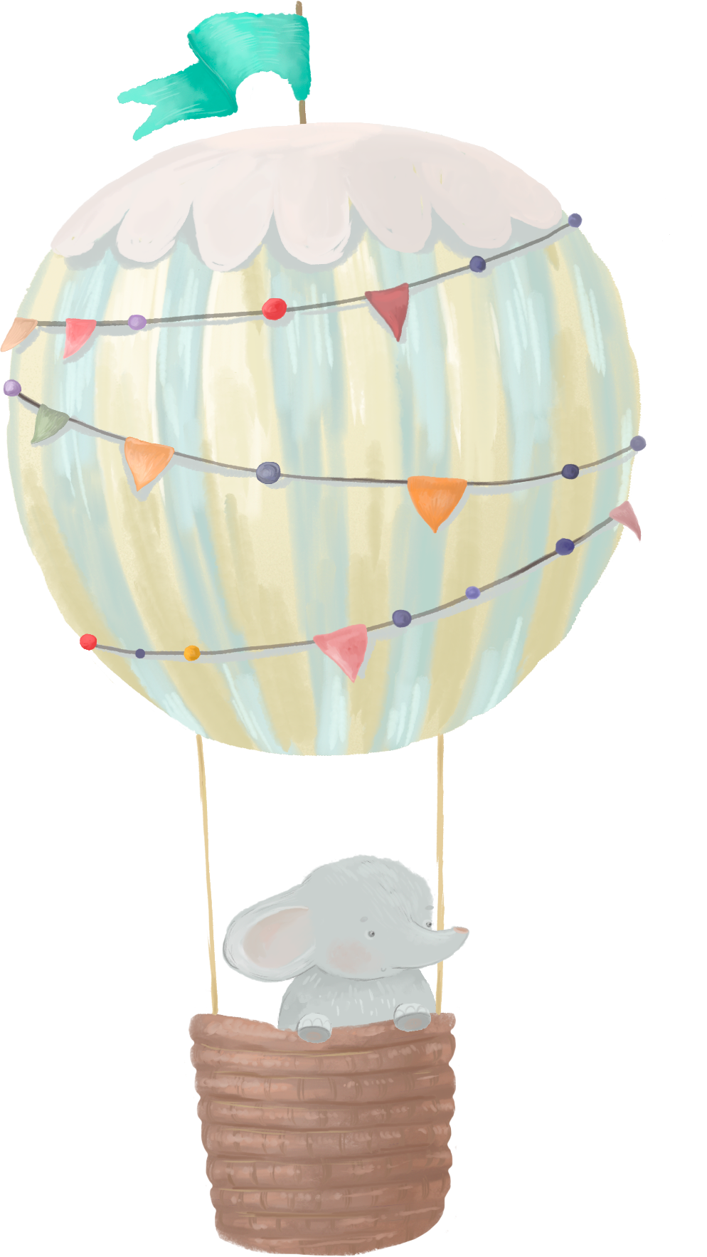


Oh
Baby!
OLIVIA’S
BABY SHOWER
June 19, 2030

